Slide 1
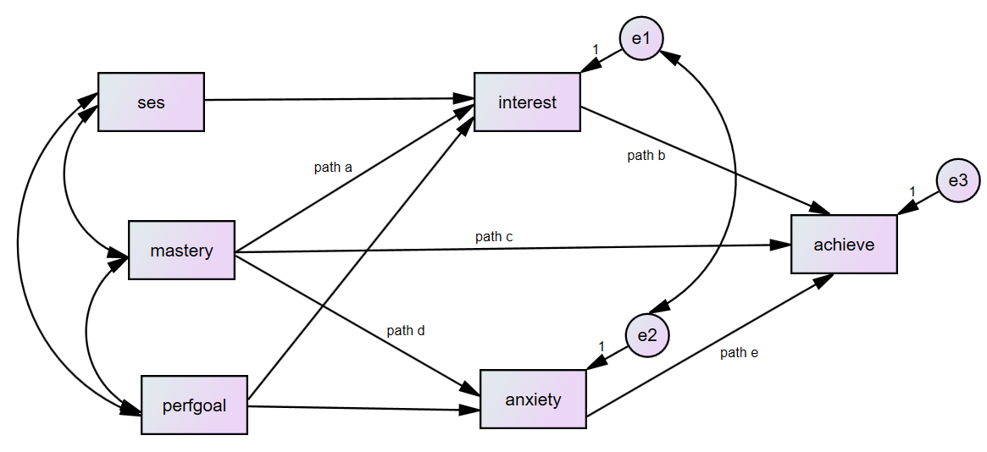
Indirect and total effects of mastery goals on achievement:
First specific indirect effect:
SIE1=path a*path b
Second specific indirect effect:
SIE2=path d*path e
Total indirect effect:
TIE=SIE1+SIE2
Total effect of mastery on achieve
TE=TIE + path c

